Slide 1
PNEUMONIA DETECTION USING CNN MODELS
Team members:- Group:39 Panel number: 21
S.No | Reg.No | Name of the Student | Section
1 | CB.EN.U4CSE17265 | Madhav Vempaty | CSE C
2 | CB.EN.U4CSE17363 | T Jaya Bharath Reddy | CSE D
3 | CB.EN.U4CSE17617 | C Sai Teja | CSE F
4 | CB.EN.U4CSE17665 | T Srinivasa Manoj Reddy | CSE F

Slide 2
Problem Definition
To analyse and classify the given Chest X-ray image into Pneumonia or normal using Convolution Neural Networks of Deep Learning Models.

Slide 3
Introduction
Pneumonia is a deadly disease caused due to bacteria,fungus and virus.However,radiologists have to get the accurate information of the patient so that he is ready for medication.
This is where our problem statement has come into existence.We have to get the faster and accurate details of the chest x-ray of patient.
We found resnet 50 and vgg 16 are the two important algorithms of a image classification in deep neural network.
By using this Convolution neural network models which are mainly to analyse visual imagery.
Now we are going to discuss deeply how we have applied our algorithm to train ,validate and test with our dataset to achieve the results.

Slide 4
Literature Survey

Slide 5
Learning to Recognize Chest X Ray based on Multi-Kernel Depthwise Convolution
This paper aims to automatically diagnose diseases on X-rays images quickly and effectively. It has the multi-kernel depthwise convolution which contains kernels with different filter sizes in convolution layer.
It is appropriate for medical images diagnosis tasks in which abnormalities varied in sizes. Larger depthwise kernels are adopted in MD-Conv to obtain a larger receptive field efficiently.

Slide 6
Efficient detection using Chest X ray Images Using Deep
Transfer Learning
In this work, an efficient model for the detection of pneumonia trained on digital chest X-ray images is proposed.
A novel approach based on a weighted classifier is introduced, which combines the weighted predictions from the deep learning models such as Xception, DenseNet121, and MobileNetV3 in an optimal way.

Slide 7
InstaCovNet-19: A deep learning classification model for the detection patients diesease using Chest X-ray
An integrated stacked deep CNN InstaCovNet-19 is proposed. The proposed model makes use of various pre-trained models to compensate for a relatively small amount of training data.
The proposed model detects the abnormalities caused by such diseases in chest X-ray images of the person infected.

Slide 8
Deep Convolutional Neural Network with Transfer Learning for Detecting on Chest X-Rays
This Paper Proposes an automatic diagnostic tool based on a deep neural network convolutional model for diagnosis training and Model building is done on the dataset.Transfer learning is Used in this Model
In Model Training Phase Inceptionv3 is Used and this algorithm contains the repetition of blocks known as Inception Block and parameter and it safely preserves all the features of the image without disturbing the image features

Slide 9
Deep Learning for Medical Image Segmentation
Model is Built and Trained and Used.Dataset is the medical dataset containing X-ray Images and Images Over 1 lakh across 3000 patients containing 14 diseases including pneumonia
Pretrained Models of Algorithms Mentioned are Used and fine tuning is applied on the algorithms and it changes and freezes all the layers and modification is done to the layers

Slide 10
Pneumonia Classification of thorax images using convolutional neural networks
This study is for the thorax image classification using Convolutional Neural Network.
To obtain better approximations for the thorax images and to obtain high accuracy adaptive momentum is used during the training phase.

Slide 11
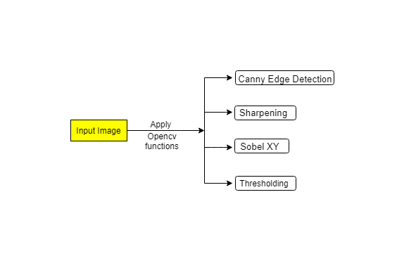
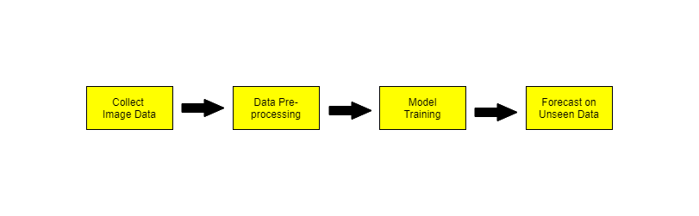
System Design

Slide 12
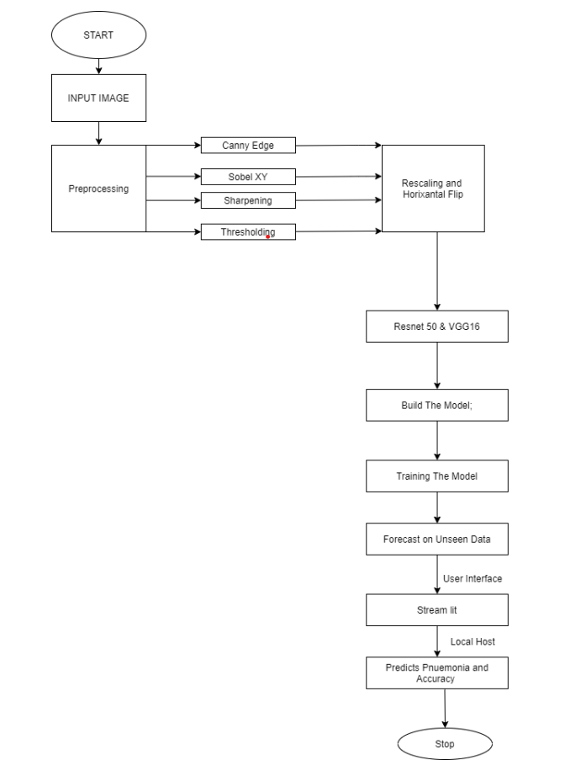
Flow Diagram

Slide 13
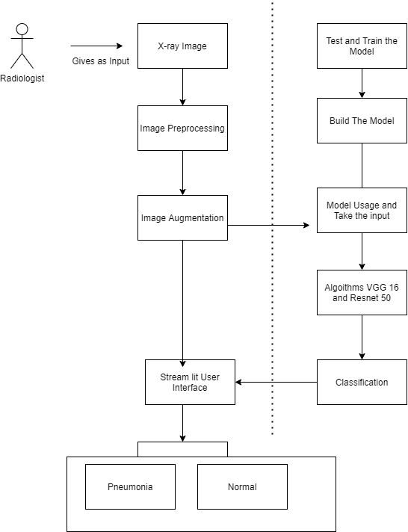
Architecture Diagram

Slide 14
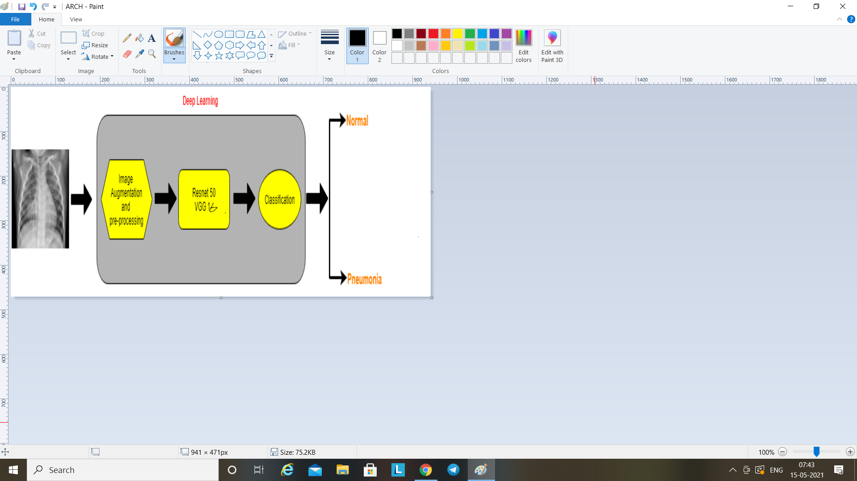
Architecture Diagram

Slide 15
Our main goal of the system is to get the correct prediction whether the patient is suffering from the pneumonia or not.
An x-ray is given as an input to the system, the image is aligned as per the horizontal flip to get the image to be test , trained and validated.
Here we are using the main image classification algorithms of cnn to name particularly vgg and resnet 50.
But we finalised with the resnet after the comparison of the two classification algorithms used.
Finally, we are able to classify the x-ray of patient with best results.
Features of Architecture Diagram

Slide 16
Modules
S. NO. | MODULES
1 | Data Collection
2 | Image Processing & Data Augmentation
3 | Implement Architecture & Create data generators
4 | Train the Model by defining loss function & callbacks
5 | Test the Model on Unseen data

Slide 17
Dataset
Link: https://www.kaggle.com/paultimothymooney/chest-xray-pneumonia
File Format: Images (.JPEG)
The dataset is organized into 3 folders (train, test, val) and contains subfolders for each image category (Pneumonia/Normal). There are 5,863 X-Ray images (JPEG) and 2 categories (Pneumonia/Normal).

Slide 18
Data Preprocessing
The dataset is a medical kind of data set which consists of chest x-ray images.All the important libraries are included and some of the open cv functions are used.
So we have used most consistent open cv functions like canny edge detection,Sobel XY.
Canny edge detection technique,not just a plain edge detection technique.It has an additional feature.It also suppresses the noise while detecting the edges flawlessly.

Slide 19
.
Sobel Edge Detector Technique:
At first ,the image is refined in the X and Y directions respectively.The new image is formed while obtaining the result, which actually is the addition of the X and Y edges of the image.This approach works through calculation of the image intensity at every pixel within the image.It has two kernels(3*3 matrix).One of them correspond the X(horizontal) and the other shall be used for the Y(vertical) direction.These two kernels shall be convoluted with the original image under process and through which the edge points are calculated with ease.The kernel values are fixed for sobel filter and cannot be altered. The Gaussian filter play a vital role in the entire process.

Slide 20
.
Canny edge detection technique:
Canny edge detection technique,not just a plain edge detection technique.It has an additional feature.It also supressess the noise while detecting the edges flawlessly. It mainly converts the rgb image to greyscale. Gaussian Blur is an operator,which helps in removing the noise in the input image.This noise removed image shall enable further processing to be smooth and flawless. The sigma value has to be set appropriately for better results.Intensity Gradient Calculation is sobel filter is to be used in the process.Sudden intensity change is the edge and in fact,the intensity change of the pixel is the edge.Now the sobel operator has to applied over the input image and the steps and sequences remain the same as the process explained in the Sobel Edge Detection process. The resultant Sobel operator image is generated and is referred as Gradient Magnitude of the image.

Slide 21
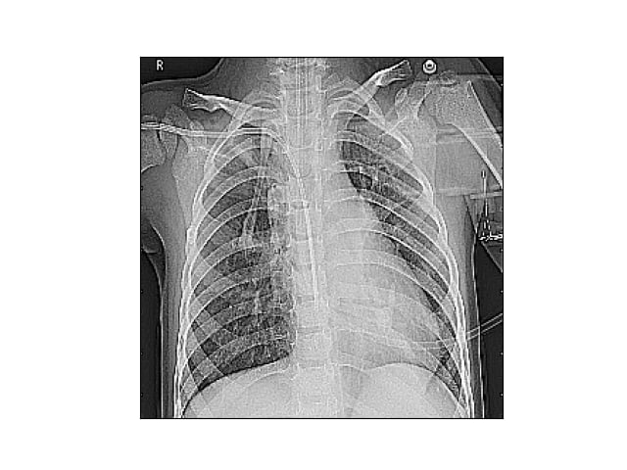
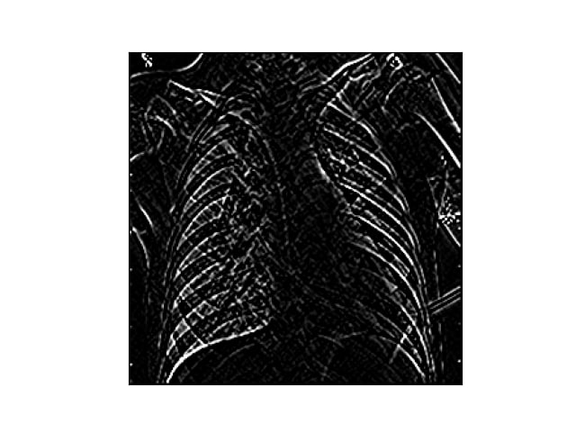
Image Processing

Slide 22
Implementation

Slide 23
Model Training
We have two algorithms resnet 50 and vgg 16 algorithm that are used to train,validate and test.
The main reason for taking Resnet50 architecture into consideration is that during training process the gradient loss is reduced at particular network level depths.As the chest xray image which contains high level visualization.

Slide 24
Model Training
This convolution models are first developed according to our data set and our requirements of the loss less functions of the data.
Which results in the training,validating and testing the models without loss of the main images as per our data set.

Slide 25
Resnet 50 classifier
This model is available for both Theano and tensorflow backend
We have used the tensorflow to train and test our dataset
Reason to take tensor flow is our dataset is completely a image dataset as in which length and height are given at most important
Tensorflow is the one which by default takes the length and height so we have build the model using tensorflow
The default size of the model is 224X224

Slide 26
Resnet 50 classifier
This model is implemented using the keras model.
This contains the identity block and convolution block
The identity block is used when there is no change in the input and output dimensions of the images.
A conv block consists of a convolution layer with relu activation function .It separately compresses both input features before combining them to compute predicted class labels

Slide 27
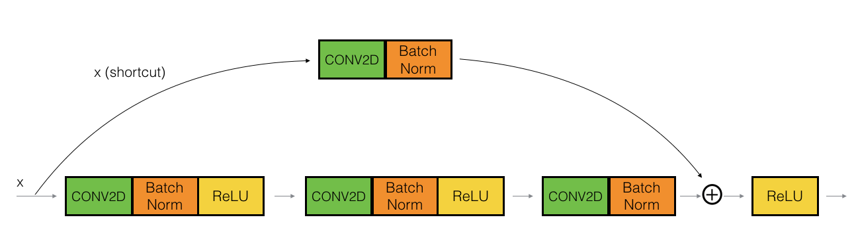
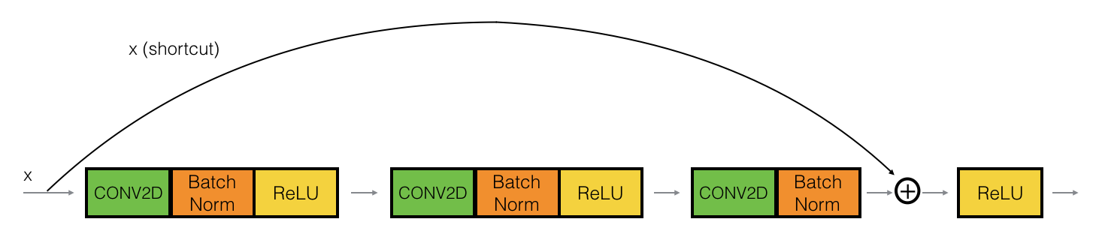

Slide 28
VGG 16 Classifier
VGG16 is a convolutional neural network and It Only has Conv and pooling layers in it and Number 16 refers that it has a total of 16 layers that has some weights.
The Kernel size is 3x3 and the pool size is 2x2 for all the layers it always use a 3 x 3 Kernel for convolution and 2x2 is the size of the max pool.
It has an accuracy of 92.7%.and Trained on ImageNet data
The network architecture weights themselves are quite large

Slide 29
VGG 16
The reason for taking vgg 16 is that large scale dataset has been successfully classified by this algorithm and the default properties of imagenet makes the algorithm work effectively even with large scale data
Max Pooling is done in VGG16 .
70-30 Rule
Weights- Imagenet

Slide 30
Comparison
Resnet50:
It is a CNN.
Computationally light.
Residual Blocks are used to flow information between previous block and next block.
ResNet is much deeper than VGG.
Deep Residual Learning for Image Recognition

Slide 31
.
VGG:
It is a CNN.
Very Deep Convolutional Networks for Large Scale Image Recognition
It is painfully slow to train.
The network architecture weights themselves are quite large (in terms of disk/bandwidth).

Slide 32
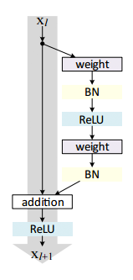
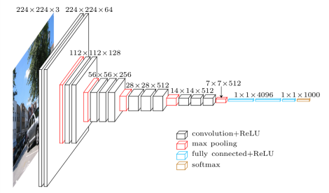
Comparison

Slide 33
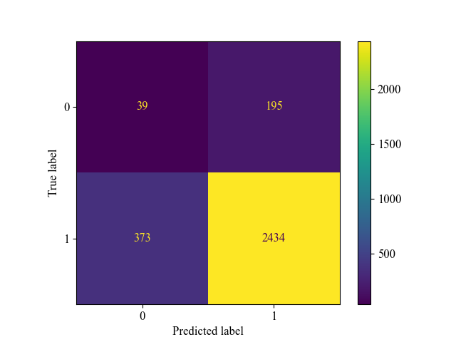
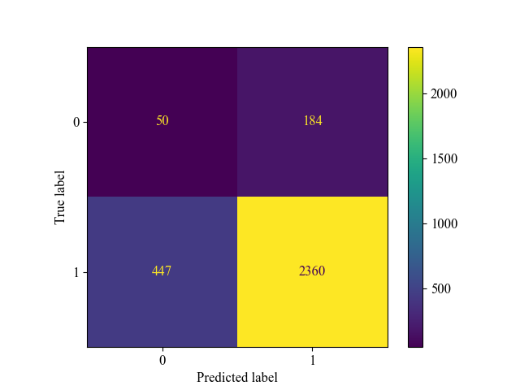
Confusion Matrices of Resnet50 and Vgg16

Slide 34
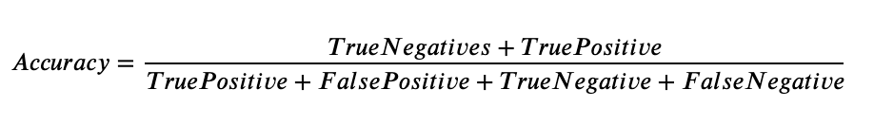
.
Model Evaluation:
To check the performance of the model, we evaluate the model on unseen data.
We have used performance metric accuracy from confusion matrix to predict the output.

Slide 35
Statistics
Chosen Category | Resnet50 | Vgg16
Normal images under Train Folder | 1264 | 1264
Pneumonia images under Train Folder | 1379 | 1379
Normal images under Validation Folder | 86 | 86
Pneumonia images under Validation Folder | 86 | 86
Normal images under Test Folder | 234 | 234

Slide 36
Pneumonia images under Validation Folder | 2807 | 2807
No. of epochs | 60 | 60
Average running time for each epoch | 6 min | 20 min
Least Training loss | 0.5430 | 0.5224
Least Validation loss | 0.51470 | 0.53350
Best Training accuracy | 0.7791 | 0.7682
Best Validation accuracy | 0.8500 | 0.8731
Accuracy Score | 0.8132193357448207 | 0.7925024662939822

Slide 37
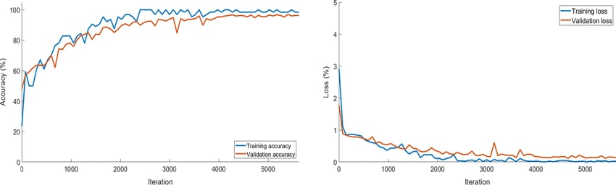
Vgg16 accuracy comparison

Slide 38
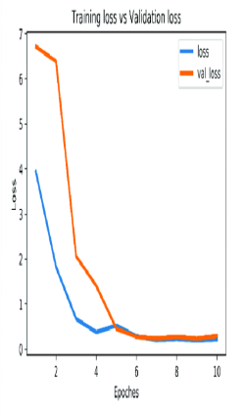
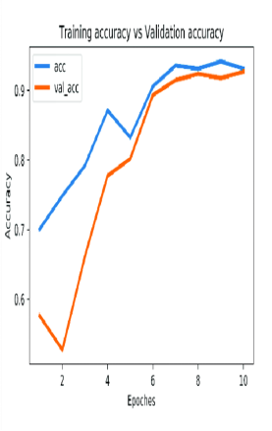
Resnet50 accuracy comparison

Slide 39
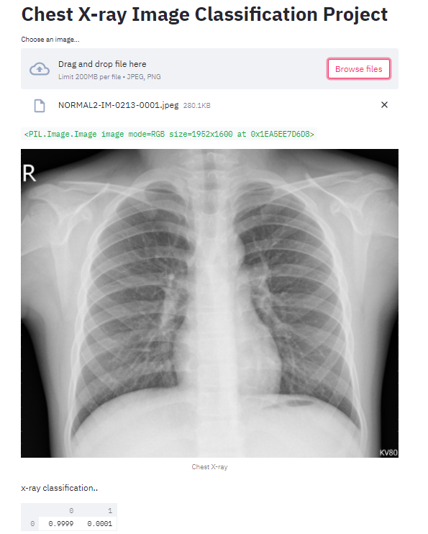
Result/Inferences
Normal Image:

Slide 40
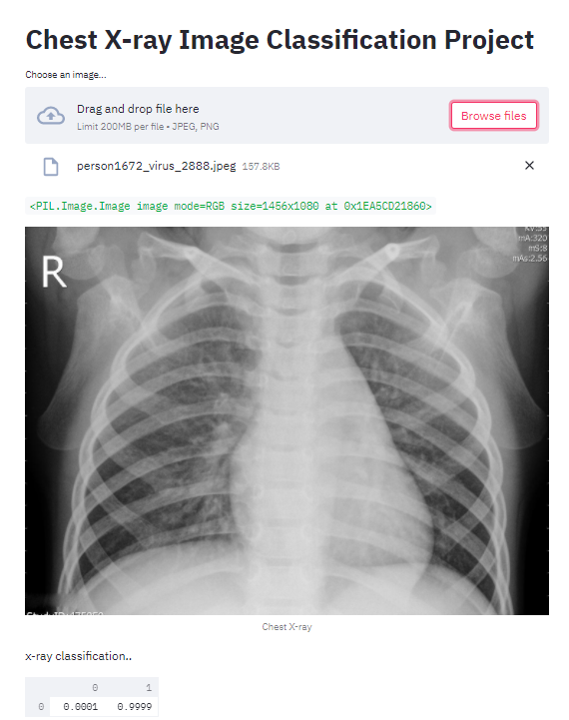
Pneumonia Image:

Slide 41
Future Enhancement
For future research would focus on distinguishing patients showing mild and severe Pneumonia symptoms.
we will attempt to utilize our approach on bigger datasets, to tackle other medical problems like cancer, tumors and so forth.
Future research directions will incorporate the exploration of image data augmentation methods to improve accuracy even more while avoiding overfitting.

Slide 42
.
Another future direction from this research will broaden the model implementation on conventional smartphone processor to do quick and modest on-device inference .

Slide 43
Conclusion
We have used two algorithm models Resnet 50 and VGG 16.These models are pre trained in the Imagenet database to detect Pneumonia in chest xray images.
With a limited number of images in pneumonia category we have obtained more accuracy in the two models.
It will be possible to improve the quality of training with more images in the pneumonia category.It can be helpful for doctors and researchers to make decisions on clinical practice.

Slide 44
References
1. aiswal, A.K., T. P. K. S. G. A. D. K. A. R. I. (2019). “Identifying pneumonia in chest x-rays: a deep learning approach.” Measurement 145, 511–518.
2. Ayan, E. and Ünver, H. M. (2019). “Diagnosis of pneumonia from chest x-ray images using deep learning..” Scientific Meeting on Electrical-Electronics Biomedical Engineering and Computer Science (EBBT). Ieee.
3. Chhikara and Prateek (2020). “Deep convolutional neural network with transfer learning for detecting pneumonia on chest x-rays..” Advances in Bioinformatics, Multimedia, and Electronics Circuits and Signals. Springer, Singapore, 155–168.
4. Hu, Mengjie, e. a. (2020a). “Efficient pneumonia detection in chest xray images using deep transfer learning..” Diagnostics 10.6, 417.
5. Hu, Mengjie, e. a. (2020b). “Learning to recognize chest-xray images faster and more efficiently based on multi-kernel depthwise convolution..” IEEE Access 8.

Slide 45
References
6. Kim, D.H., M. T. (2018). “Artificial intelligence in fracture detection: transfer learning from deep convolutional neural networks. clin. radiol..” 73(5), 439–445.
7. Rachna Jain Preeti, Nagratha Gaurav, K. K. D. H. (2019). “Artificial intelligence in fracture detection: transfer learning from deep convolutional neural networks. clin. Ra diol.
8. Suyuti, M. and Setyati., E. (2020). “Pneumonia classification of thorax images using convolutional neural networks..” Inform 5.2.
9. Tatiana Gabruseva, Dmytro Poplavskiy, A. A. K. (2020). “Deep learning for automatic pneumonia detection.
10. V. Sirish Kaushik, Anand Nayyar, G. K. R. J. (2020). “Pneumonia detection using cnn.

Slide 46
THANK YOU

